Slide 1
To SQL and to noSQL
17th October 2019

Slide 2
This week
Got your first NodeJS apps to run?
Hello world
Simple chat
NodeJS: JavaScript based web server
Next step: connecting your web server to a database server
We want to consider the special case of MongoDB
Uses JavaScript idioms for database operations
A noSQL database program

Slide 3
The evolution of data storage
Explosion of social media sites with large data needs, e.g. Facebook, Twitter
Explosion of storage needs for large web sites, e.g. Gmail, Youtube
Most of the data are not files
Consequence → need dynamically-typed data storage, with frequent schema changes

Slide 4
Parallel data storage
Web-based applications have large demands on data volume and transaction rate
Scalability of application servers is easy, but what about the database?
Approach 1: Caching
Reduces database access
Limited in scalability
Approach 2: Use parallel databases
Expensive
Approach 3: Build parallel stores with databases underneath
Complicated and expensive

Slide 5
Scaling RDBMS by partitioning
“Sharding”
Divide data amongst many cheap databases
Manage parallel access in the application
Scales well for both reads and writes
Not transparent: application needs to be partition-aware
Sharded systems and key-value stores don’t support many relational features
No joins operations across partitions
No referential integrity constraints across partitions
Weak SQL

Slide 6
Weak SQL → noSQL
Non-relational database systems
BigTable, Dynamo, MongoDB etc.
Usually don’t require a fixed table schema
Don’t use the concept of joins
Easier to store data distributed across multiple servers
All NoSQL offerings relax one or more of the ACID properties

Slide 7
CAP theorem
Three properties of a database system
Consistency (all copies have the same value)
Availability (system can run even if parts have failed)
Partitions (system can break into two or more parts, each with active systems that can talk to other parts)
Brewer’s CAP theorem: you can have at most two of these three properties in any parallel system
Very large systems will partition at some point
Choose one of availability and consistency
Parallel RDBMS choose consistency
Most web applications care more about availability
Except for critical components like order processing etc.

Slide 8
Eventual consistency
When no updates occur for a long period of time, eventually all updates will propagate through the system and all nodes will be consistent
For a given accepted update and a given node, eventually either the update reaches the node or the node is removed from service
Known as BASE (Basically Available, Soft state, Eventual consistency)
Contrast with ACID
Soft state: copies of a data item may be inconsistent
Eventually consistent: copies become consistent at some later time if there are no more updates to that data item

Slide 9
Advantages of noSQL
Cheap, easy to implement, mostly open source
Data are replicated at multiple nodes (redundancy, fault tolerance)
Easy to partition
No single point of failure
Don’t require a schema
Allow frequent changes to schema

Slide 10
Limitations of noSQL
No ability to join
ACID properties are lost
Integrating with legacy applications running RDBMS becomes a pain
Lack of schema can cause chaos, lead to undisciplined application design

Slide 11
NoSQL data storage: classification
Uninterpreted key/value
Amazon S3
Flexible schema
BigTable, Cassandra (ordered keys)
Sherpa, MongoDB (unordered keys, JSON)
CouchDB (name/value, text)
MongoDB has gained popularity because it is
Free
Fast
Uses JavaScript idioms

Slide 12
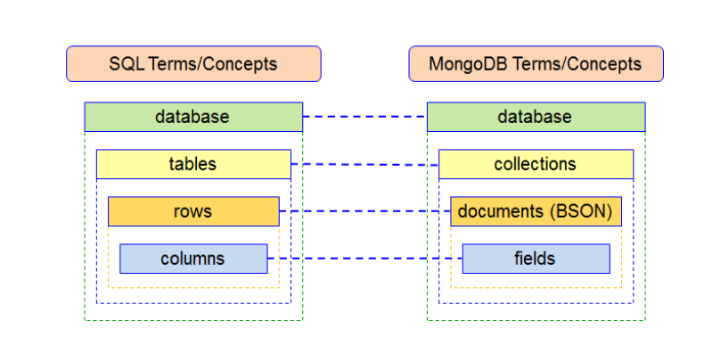
SQL → MongoDB

Slide 13
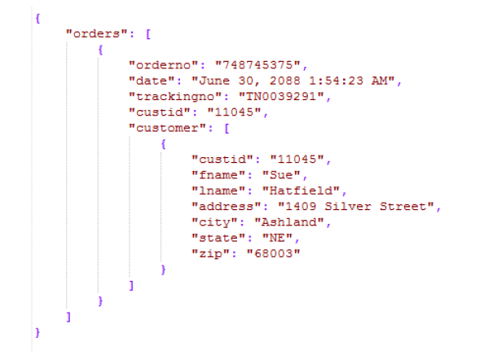
A typical MongoDB document

Slide 14
Importing data into MongoDB
Importing from csv files and JSON objects is easy
See here for documentation
Can import from python pandas dataframes using odo

Slide 15
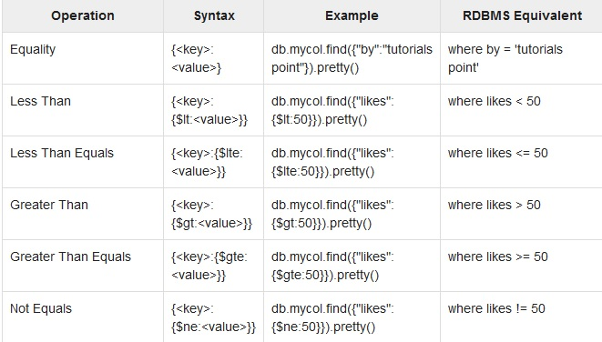
Mongo querying
General syntax
db.collection.query({“query key”: “query value”})

Slide 16
Aggregation
Very powerful functionality in MongoDB
Aggregation operations
group values from multiple documents and
perform a pipeline of operations to
return a final result
General syntax
db.collection.aggregate({Query 1}, {Query 2}, ….)
Query 2 is performed on the output from Query 1, and so on

Slide 17
Aggregation primitives
$project: used to select some specific fields from a collection
$match: filters out specific documents from the collection
$group: groups documents by field values
$sort: sorts the documents
$unwind: Unwinds document fields that are using arrays as fields
See here for a comprehensive list

Slide 18
An imaginary aggregation operation
What does Rohit Sharma average in the second innings of Test matches when chasing scores in excess of 300?
First $match on player name
Then $match on innings number
Then $match on target
Then add all scores in the remaining innings using $sum
$count completed innings
Divide result from the first query by the result from the second query

Slide 19
Next week in lab
Grab the master fork from this repo.
Download the cases.json file from the course website
Import it into a mongodb database on your localhost
Perform basic CRUD operations in the mongo shell
Connect the database to the express app and have the app tell you
Which district has the most crime reported per capita
Which police station is the most inefficient in completing investigations
Which crime laws are most and least uniquely applied in FIRs

Slide 20
JavaScript app assignment (updated)
Supersedes earlier announcement
I said MEAN, but it can be MERN, CMAN, or any other stack, so long as its built on NodeJS at the back end
Must demo by 13th November
Project specs
Mobile front-end (15% credit)
Should read and write to a database (10% credit)
Should perform at least two front-end view manipulations without pulling from the server (15% credit)
Should use at least on native mobile function (10% credit)
Should have secure login management, fine to use Passport (15% credit)
Database should be secured separately (10% credit)
Should protect against XSS attacks
Project complexity and implementation competence (25% credit)

